Slide 1

BULBASAUR
When seconds count, our intelligent system spots fires before they spread, combining satellite imagery and weather data to keep your community one step ahead of danger. Like having a guardian angel powered by AI, Bulbasaur watches over what matters most.
Your Digital Guardian Against Wildfires
https://voxel51.codestacx.com/

Slide 2
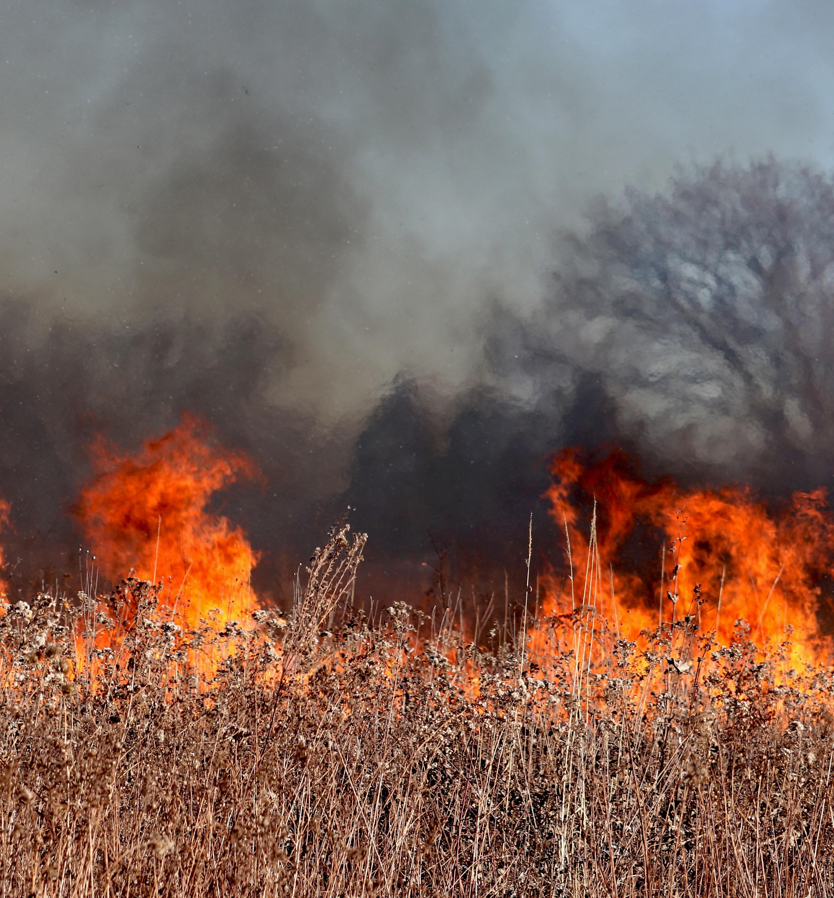
BULBASAUR
Impact
When seconds count, our intelligent system spots fires before they spread, combining satellite imagery and weather data to keep your community one step ahead of danger. Like having a guardian angel powered by AI, Bulbasaur watches over what matters most.
Wildfires destroyed 18.4 million acres in the US in 2022 alone
Insurance losses from wildfires exceeded $13 billion in 2023
Average cost to fight a large wildfire: $1 million per day
4.5 million US homes are at high or extreme risk

Slide 3
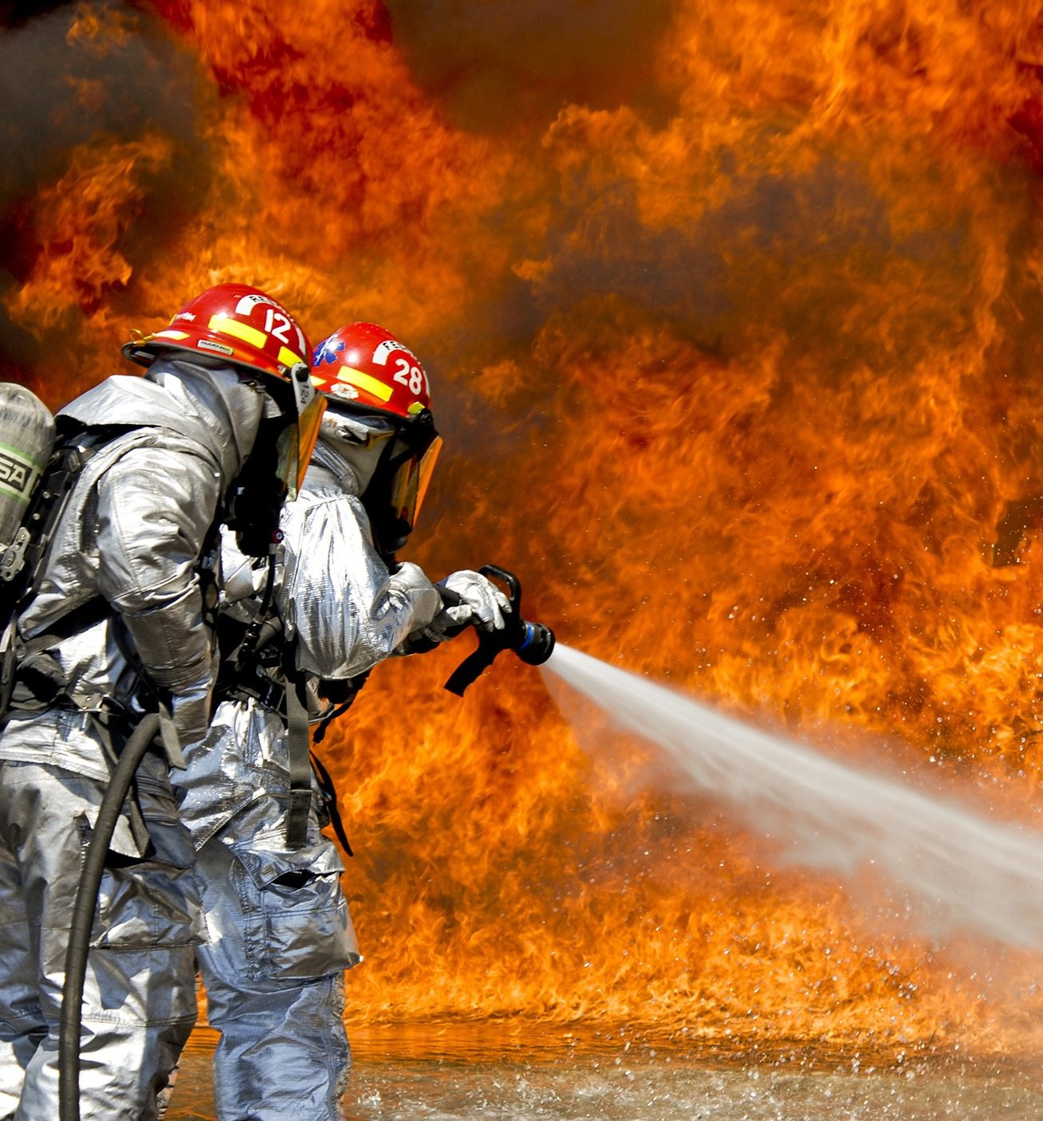
Current Problems
Impact
Wildfires destroyed 18.4 million acres in the US in 2022 alone
Insurance losses from wildfires exceeded $13 billion in 2023
Average cost to fight a large wildfire: $1 million per day
4.5 million US homes are at high or extreme risk
Traditional methods rely heavily on human spotters
Satellite detection can take up to 30-45 minutes to report
Poor performance in remote or mountainous areas
Average emergency response time: 15-20 minutes after detection

Slide 4

Current Problems
Traditional methods rely heavily on human spotters
Satellite detection can take up to 30-45 minutes to report
Poor performance in remote or mountainous areas
Average emergency response time: 15-20 minutes after detection
Detects fires within 5 minutes of ignition (vs. traditional 30-45 minutes)
Reduces false alarms by 90% through AI verification
Covers 50,000 acres per monitoring station
Instant alerts to communities and first responders
Save up to $10M in property damage per incident
Reduce response time by 80%
Protect 100,000+ lives in high-risk areas
Cut firefighting costs by 60% through early intervention

Slide 5

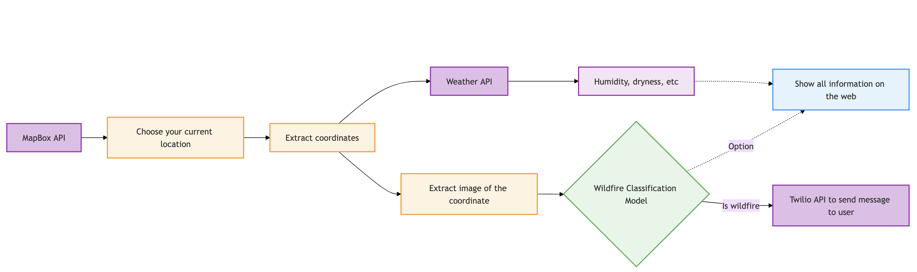
Project Bulbasaur: Your AI-Powered Wildfire Watchdog
Our Solution
Detects fires within 5 minutes of ignition (vs. traditional 30-45 minutes)
Reduces false alarms by 90% through AI verification
Covers 50,000 acres per monitoring station
Instant alerts to communities and first responders
Save up to $10M in property damage per incident
Reduce response time by 80%
Protect 100,000+ lives in high-risk areas
Cut firefighting costs by 60% through early intervention

Slide 6
Our Solution

